Slide 1


Oracle database
Lecture 18

Slide 2

Today’s Agenda
Introduction To Joins
Types Of Joins
Cartesian Join
Equi Join

Slide 3
Introduction To Joins
So far, we have written SQL statements against a SINGLE table.
Now we will discuss about retrieving data from multiple tables using JOIN , which is one of the most important aspects of the SQL language.

Slide 4
Introduction To Joins
Join is a query that is used to combine rows from two or more tables or views.
It retrieves data from multiple tables and presents a new table.

Slide 5
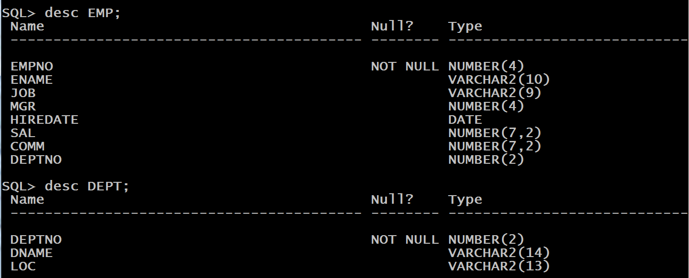
Introduction To Joins
To understand JOIN , consider the following two tables , called EMP and DEPT

Slide 6
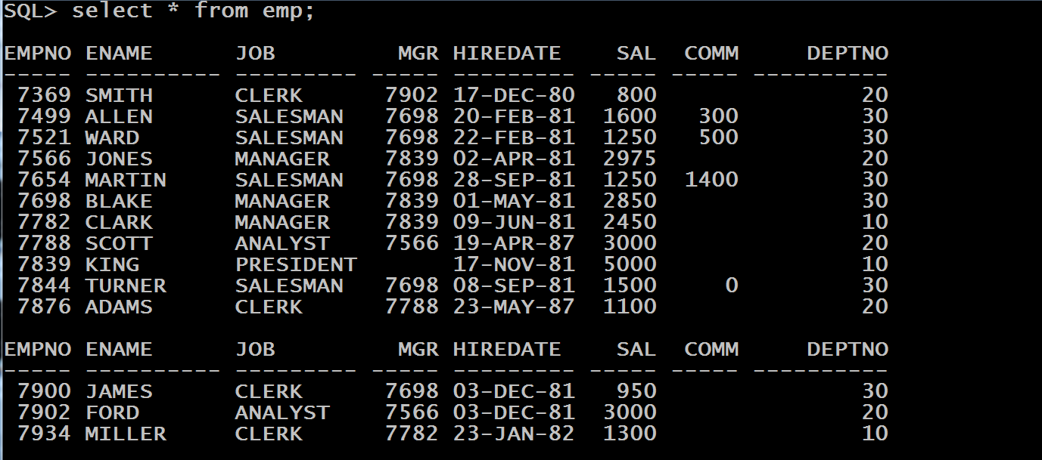
Introduction To Joins
Following are rows in EMP table:

Slide 7
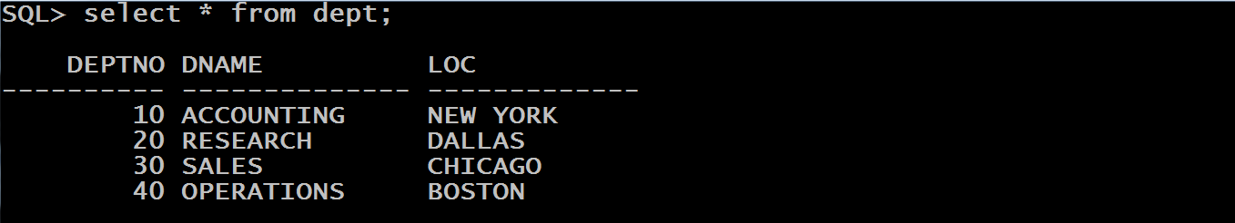
Introduction To Joins
Following are rows in DEPT table:

Slide 8
Introduction To Join
Now suppose we want a list of all the employee names with the names of their corresponding departments.
In order to solve the above query we will have to fetch the data from both the tables EMP and DEPT , because ENAME belongs to EMP and DNAME belongs to DEPT.
This is where we will have to apply JOINS.

Slide 9
Types Of Joins
Following are various types of Joins supported by Oracle:
CARTESIAN JOIN or CROSS JOIN
EQUI JOIN
SELF JOIN
LEFT OUTER JOIN , RIGHT OUTER JOIN, FULL OUTER JOIN
NON-EQUI JOIN
NATURAL JOIN

Slide 10
Cartesian Join
It is the least popular form of JOIN and is generally not used.
It happens when in the FROM clause of a SELECT query we mention 2 or more tables without using any condition.
The CROSS JOIN specifies that all rows from first table are joined with all of the rows of second table. If there are "x" rows in table1 and "y" rows in table2 then the CROSS JOIN result set have x*y rows

Slide 11
Cartesian Join
For Example:
Select ename,dname
From emp,dept;
When the above query is executed ,the output will be every possible combination of ENAME and DNAME , without matching their DEPTNO.

Slide 12
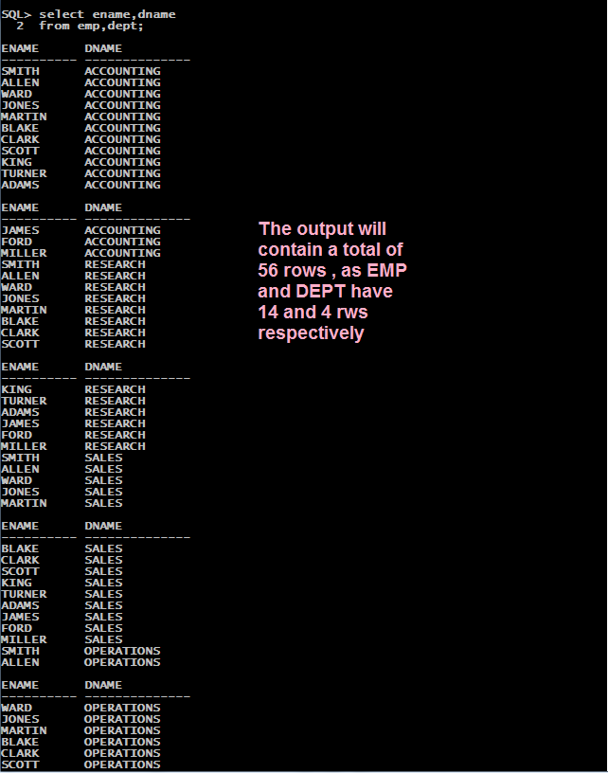
Cartesian Join

Slide 13
Equi Join
It is the most popular form of JOIN and is commonly used.
An equijoin is a join with a join condition containing an equality operator , which is represented by (=) sign.

Slide 14
Equi Join
For equi join to work , it is compulsory that the tables being joined MUST HAVE a COMMON COLUMN .
This COLUMN is used in the JOIN CONDITION.
Syntax:
SELECT column_list
FROM table1, table2....
WHERE table1.column_name =table2.column_name;

Slide 15
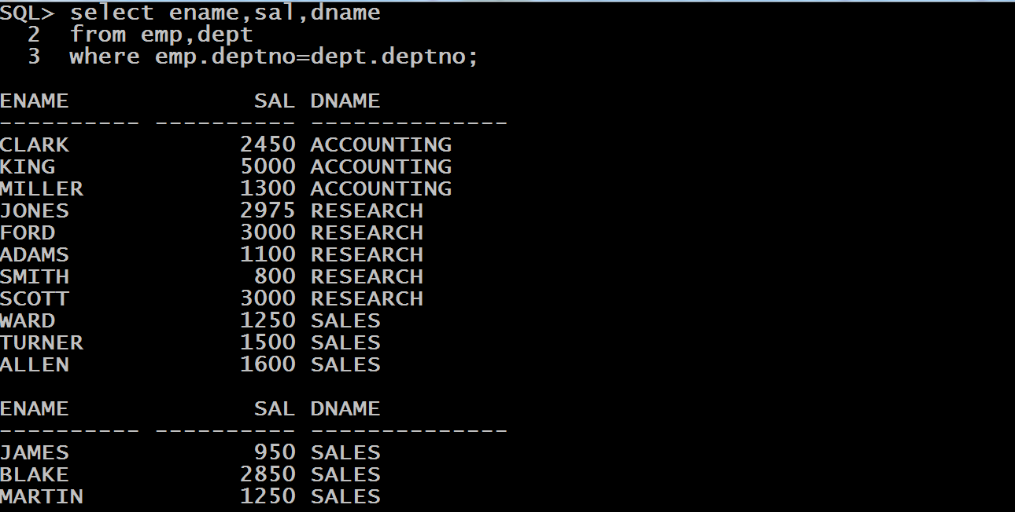
Example
WAQ to display ename ,sal and dname of all the employees in the company.

Slide 16
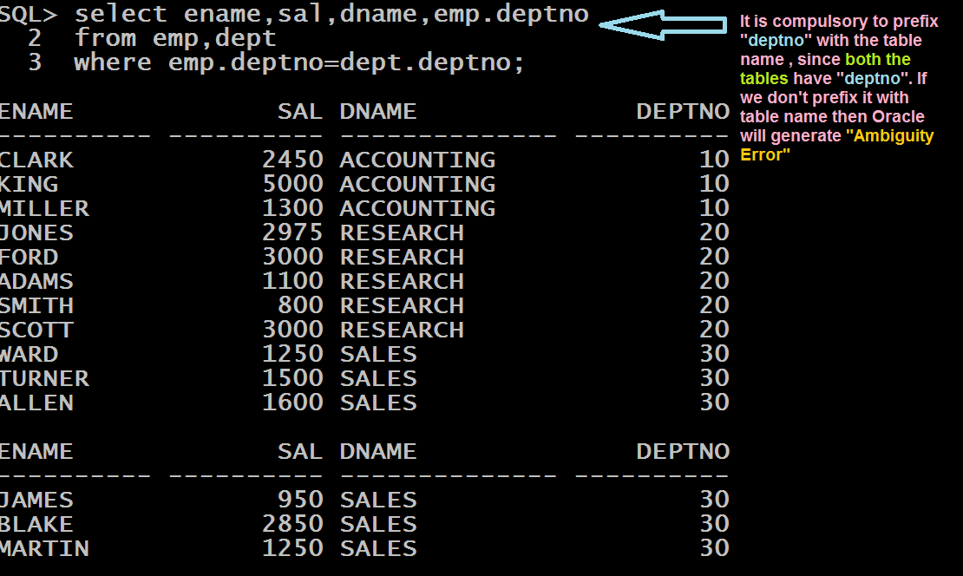
Displaying The Join Column Also
Modify the query to display deptno also in the previous output.

Slide 17
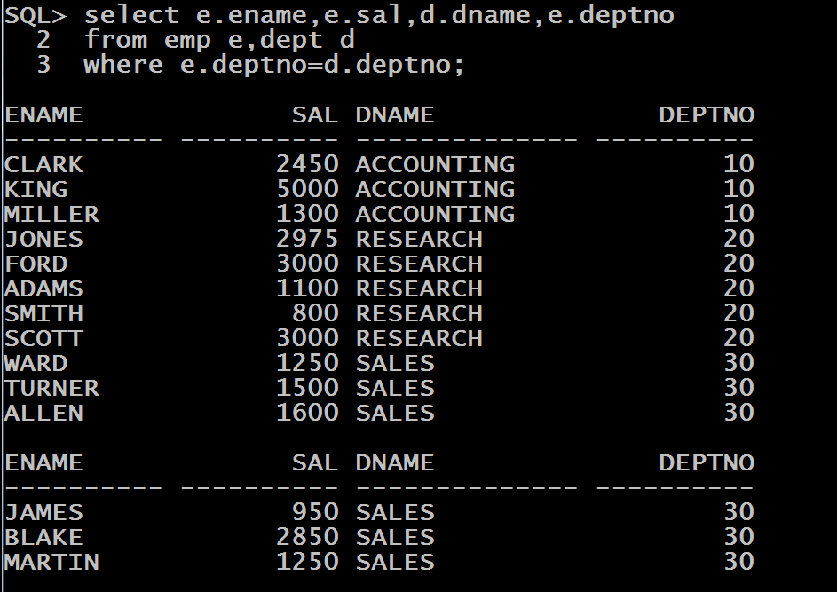
Using Table Aliases
Instead of using the table name as a prefix to differentiate between the columns, we also can use a table alias, which qualifies the table using a short abbreviation.

Slide 18
Narrowing Down The Result
The previous SQL statement lists all the rows in the EMP and DEPT tables with matching DEPTNO values.
If we want to narrow down the criteria to specific rows, then we can do this by expanding the WHERE clause to include additional conditions.

Slide 19
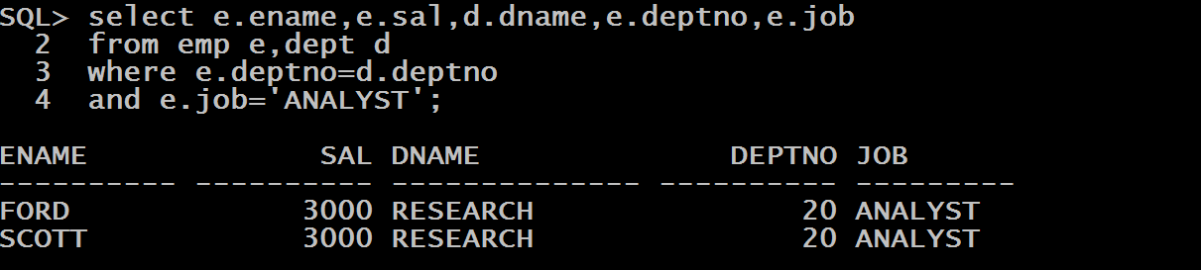
Example
WAQ to display ename ,sal ,dname,deptnoand job of all the ANALYST in the company.

Slide 20
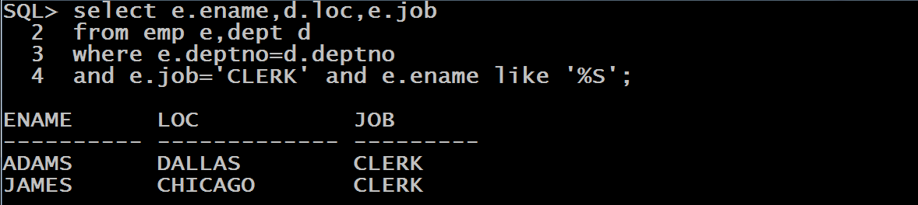
Queries
WAQ to display ename ,loc and job of every CLERK in the company whose name ends with the letter ‘S’.

Slide 21
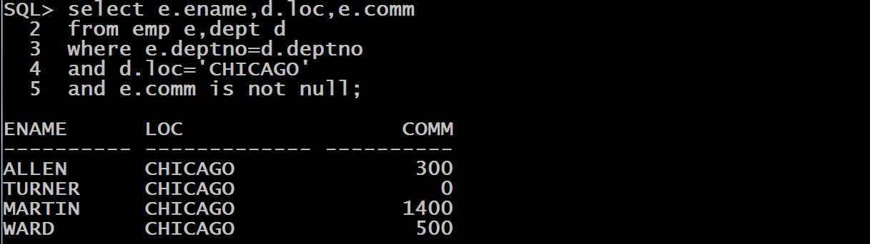
Queries
WAQ to display ename ,loc and comm of every employee who works in CHICAGOand earns a commission.

Slide 22
Equi Join And NULL
In an equijoin, a NULL value in the common column has the effect of not including the row in the result.
A NULL value is not equal to any other value, including another NULL value.
Therefore rows with NULL in join column are not included in the result.

Slide 23
Self Join
An equi join always joins two or multiple tables.
A self-join joins a table to itself by pretending there are different tables involved.
This is accomplished by using table aliases.

Slide 24
Self Join
One table has one alias, and the same table also has another alias.
For the purpose of executing the query, Oracle treats them as two different tables.
Syntax:
SELECT a.column_name, b.column_name...
FROM table1 a, table1 b
WHERE a.col= b.col;

Slide 25
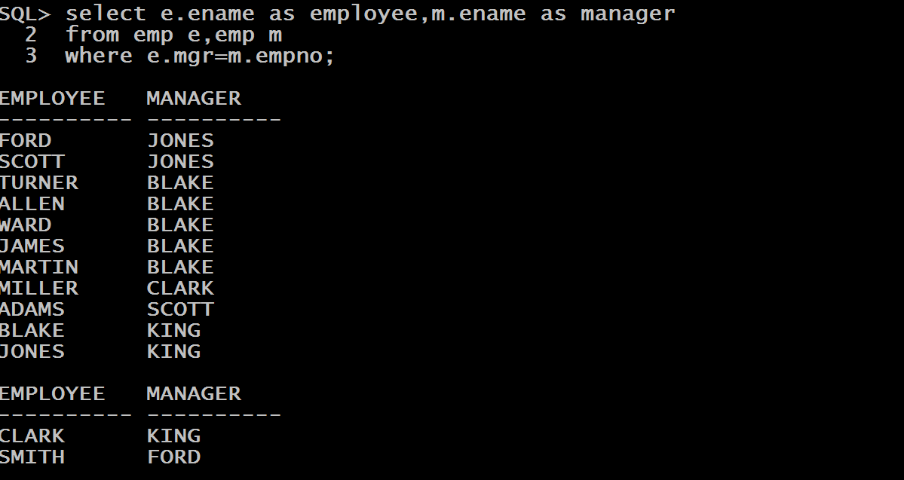
Queries
WAQ to display name of every employee along with his manager’s name

Slide 26
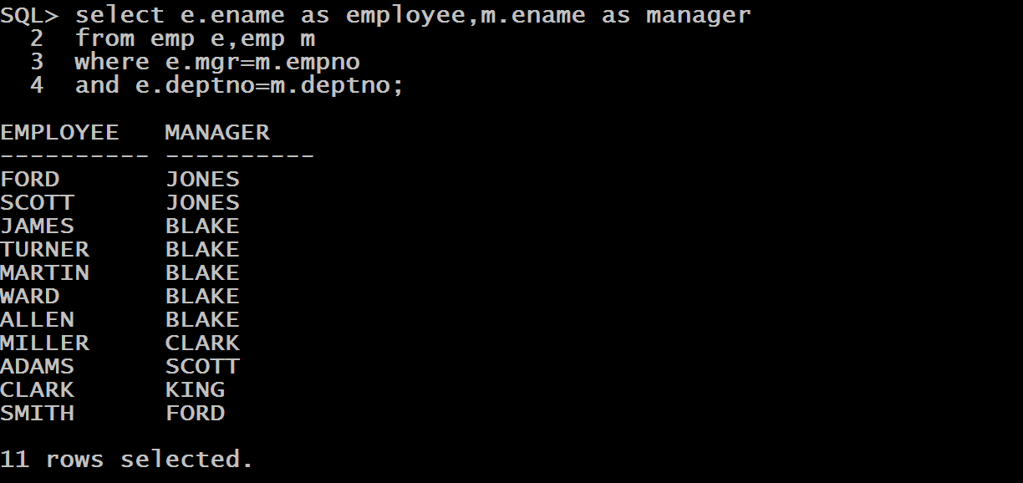
Queries
WAQ to display name of every employee along with his manager’s name of all the employees who work in same dept as their managers

Slide 27
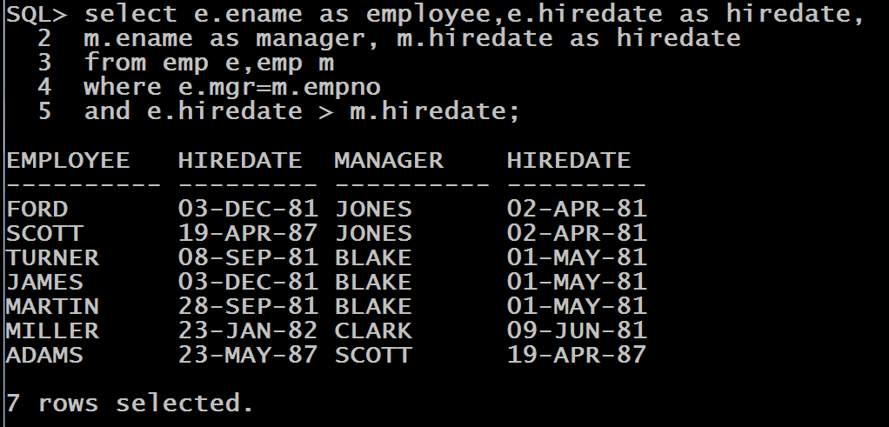
Queries
WAQ to display name of every employee along with his manager’s name of all the employees who were hired after their managers.

Slide 28
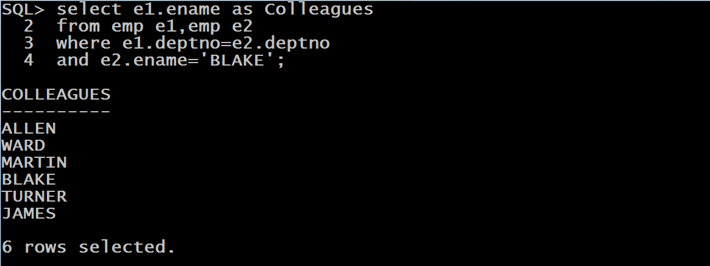
Queries
WAQ to display name of all the colleagues of the employee BLAKE.

Slide 29
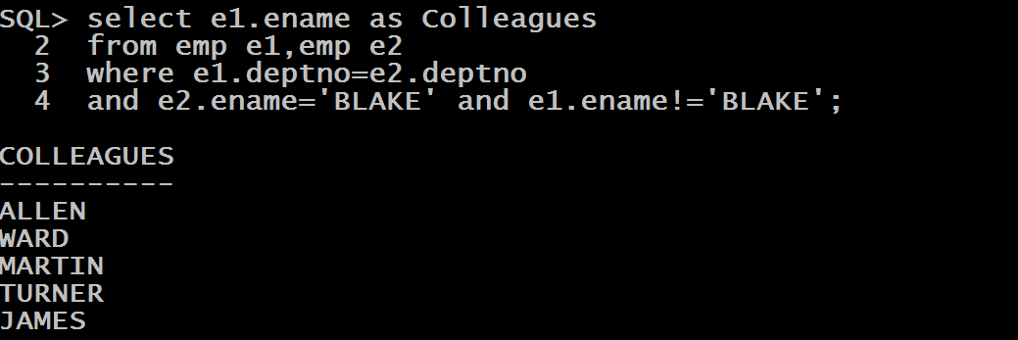
Queries
Modify the previous query to remove the name of BLAKE from the output

